Slide 1


Academy
Git 101
And… Git Exercise Teaser ☺
Anthony McKale
Principal Software Engineer

Slide 2
Agenda
- Git Overview
- Git Flow
- Git Tooling - Exercise Teaser

Slide 3
GIT OVERVIEW

Slide 4
GIT: Version Control
Modern development uses a system called “version control”
This is:
- shared drive
- Stores changes as file-sets called (commits)
- copies of drive for independent working (branches)
- copies are mergeable into one another (merging)
- special hooks to run code on events

Slide 5
GIT: History
Git History
Born in the early 00s, by Legend Linus Torvalds
Based on proprietary BitKeeper
Used originally on the Linux kernel
https://www.linuxjournal.com/content/git-origin-story
https://www.infoworld.com/article/2670360/linus-torvalds--bitkeeper-blunder.html

Slide 6
GIT: Version Control Benefits
“version control” helps development by helping:
Pulling: everyone work on common code together
Merging: share the changes
Branches: Areas for work in progress or experiments
Merge Conflict: Conflict resolution
Git Blame: Audit Trail of work done

Slide 7
GIT: Git is Local and Remote
Git is Distributed: local and remote are separate stand-alone git servers
Git has local server for individual developers
Git has master server for combining all
Local and Remote Repos send changes to each other
Can work offline locally

Slide 8
GIT: Terms
Git is made of:
Code Repo
Repo maintains every change to the code base (called a commit)
Repo maintains codebase versions (called branches)
Repo maintains fixed versions of the codebase (called tags)

Slide 9
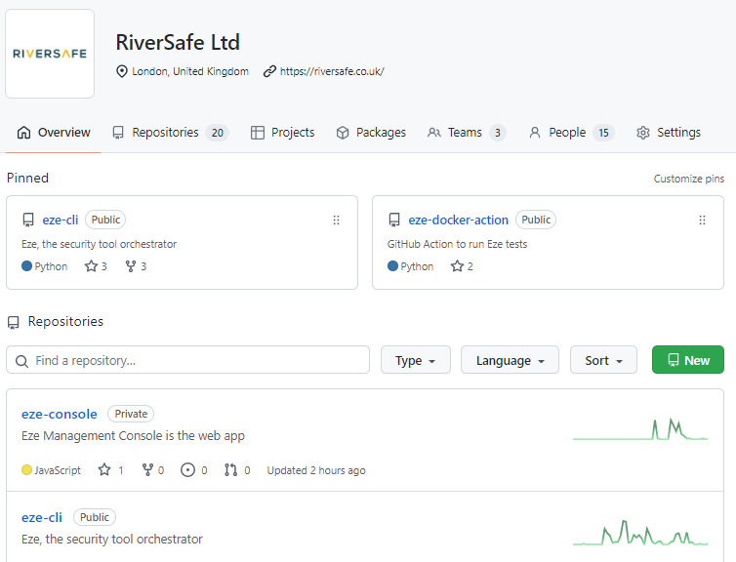
GIT: GIT Remote Server
Github is made of:
Organisations
Git Code Repos (inside orgs)
Provides Remote
Server
https://github.com/RiverSafeUK

Slide 10
GIT: GIT Remote Server
Github is a implementation
Git is the underlying tool / protocol
Gitlab; AWS Codecommit; Bitbucket; Azure Repos: just other implementations
All basically same thing, different day

Slide 11
GIT LOCAL SETUP

Slide 12
GIT: Setup Steps
Locally install GIT Software
Create Git Server User (aka Github user)
Setup local GIT to use Remote User*
Profit

Slide 13
GIT: Logging into Remote Server
Github has two CLI authentication methods
PAT – Personal Access Token newer method, available in newer git servers
SSH – SSH Key older method, available in all git servers https://docs.github.com/en/get-started/quickstart/set-up-git

Slide 14
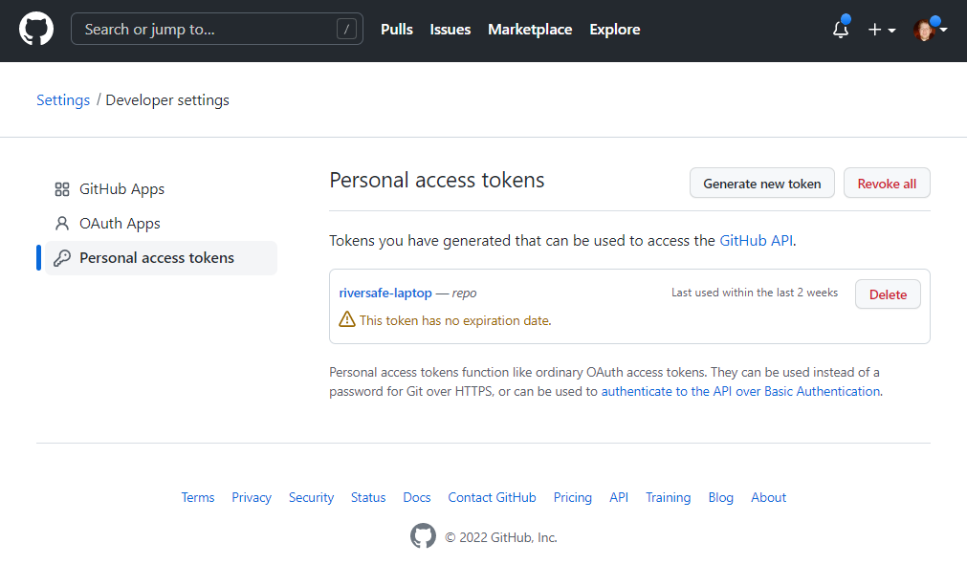
GIT: PAT
UI generated Token - only new git server + has permissions
+ has expiry + preferred Github method https://docs.github.com/en/get-started/quickstart/set-up-git

Slide 15
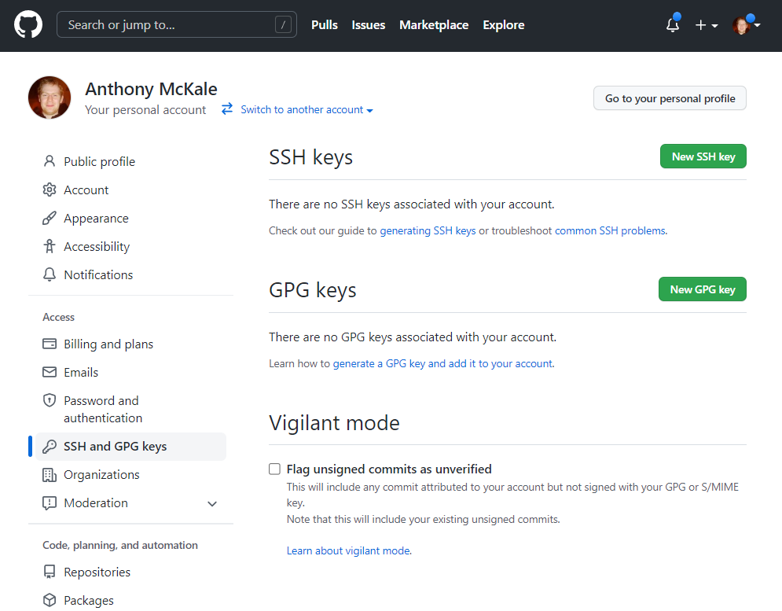
GIT: SSH
SSH Key, standard linux remote server method generated by bash command
+ Support by all git servers
- No expiry
- No permissions (Admin only) https://docs.github.com/en/get-started/quickstart/set-up-git

Slide 16
GIT REPO MANAGEMENT / VIEW

Slide 17
GIT: Repo View
Example Git via CLI (history)
https://github.com/RiverSafeUK/eze-goats/

Slide 18
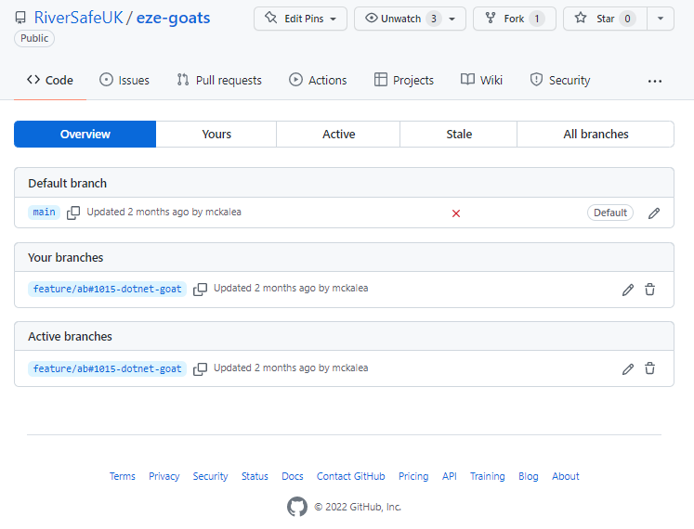
GIT: Repo View via UI
Example Git Project Page in Github
https://github.com/RiverSafeUK/eze-goats/branches

Slide 19
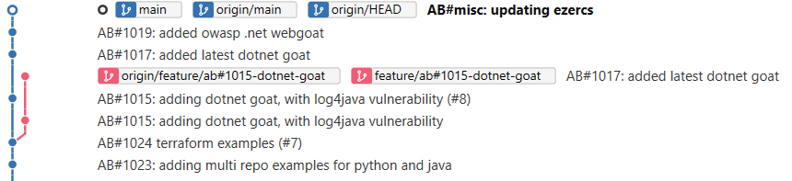
GIT: Repo View via SourceTree
Example Git Project (Tree view)
https://github.com/RiverSafeUK/eze-goats/

Slide 20
GIT: Usage
Git is a tool, it’s used for:
Separating development and production code
Separating work in progress from finished code
Tagging and versioning releases

Slide 21
GIT CLI OPERATIONS

Slide 22
GIT: Usage: Operations
Git Common Operations
Before we get started…

Slide 23
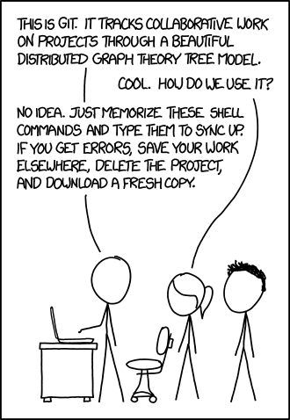
GIT USAGE
HERO
https://xkcd.com/1597/

Slide 24
GIT: Operations Common
Git Common Operations
clone remote repos to create local repos
Add / commit add changes to local repo
pull remote branch changes to local repo
push local branch changes to remote repo
branch create a copy of a branch
merge copy changes from one branch to another

Slide 25
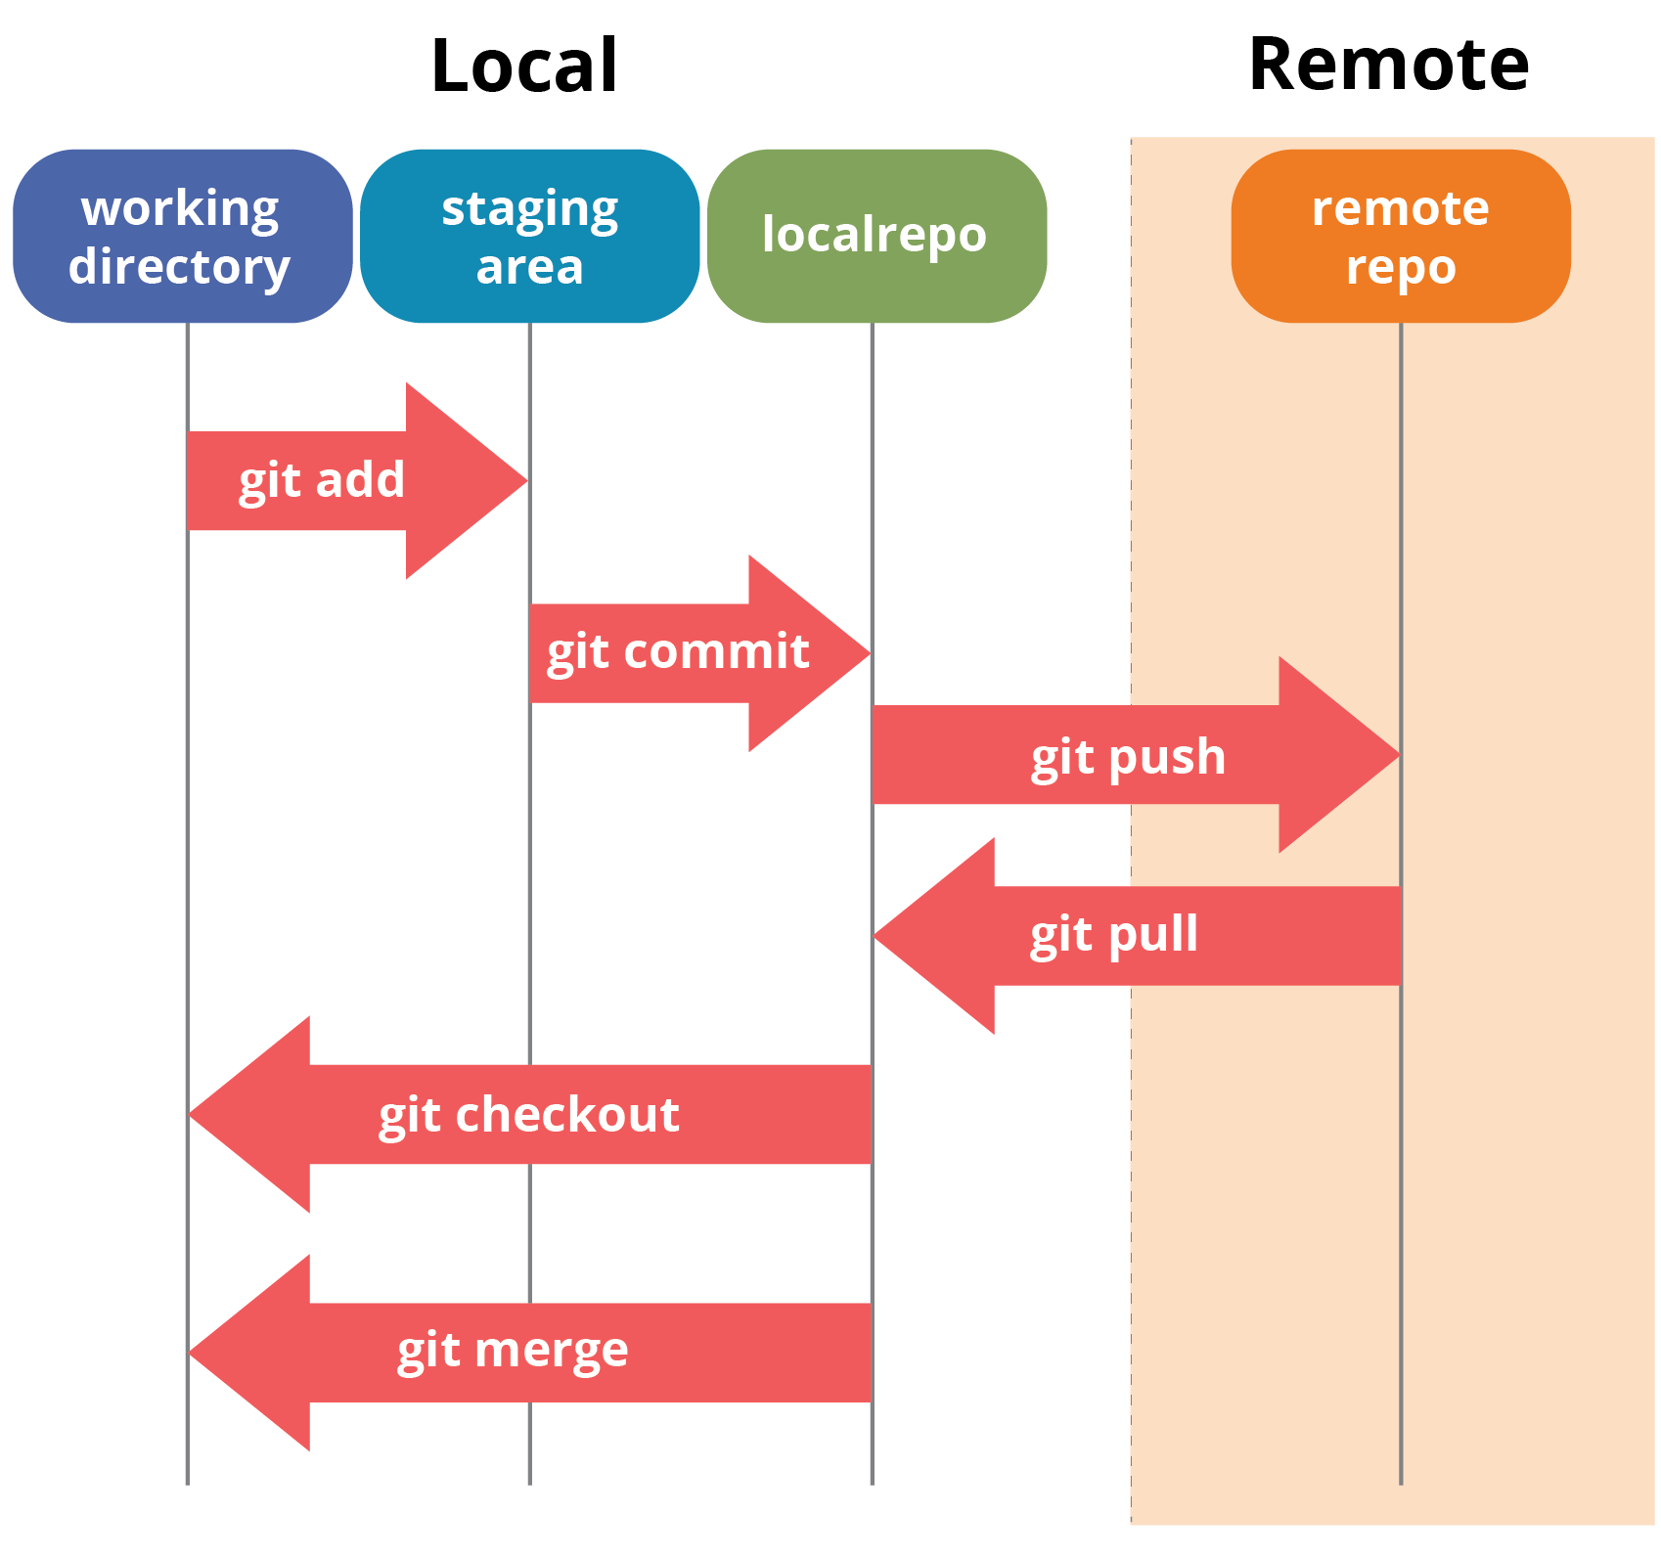
GIT: Operations by Function
Create Local Repo
clone create local repo
Commit in Branch Management
commit file system to local repo
push local changes to remote repo
pull remote changes to local repo
Branch Management
branch creating new branch
checkout downloading remote branch
merge copy from branch to branch
from https://www.edureka.co/blog/git-tutorial/

Slide 26
GIT FEATURES

Slide 27
GIT: features
.gitignore
.gitkeep
.git/hooks LOCAL
git hooks Remote
PR UI

Slide 28

GIT: .gitignore
You don’t want to store all files in version control (aka compiled / dependencies)
.gitignore is a list of files not to store, at your git root https://www.atlassian.com/git/tutorials/saving-changes/gitignore

Slide 29
GIT: .gitkeep
Git can’t store empty folders
By convention a .gitkeep file is placed in empty folders to store them in git
https://www.atlassian.com/git/tutorials/saving-changes/gitignore

Slide 30
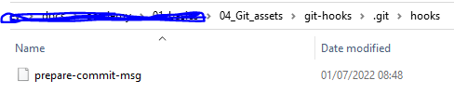

GIT: .git/hooks/…
Git hooks folder, local bash script ran when events happen Aka on pre-commit, on commit etc Bash scripts run locally on event
https://www.atlassian.com/git/tutorials/git-hooks https://git-scm.com/book/en/v2/Customizing-Git-Git-Hooks

Slide 31
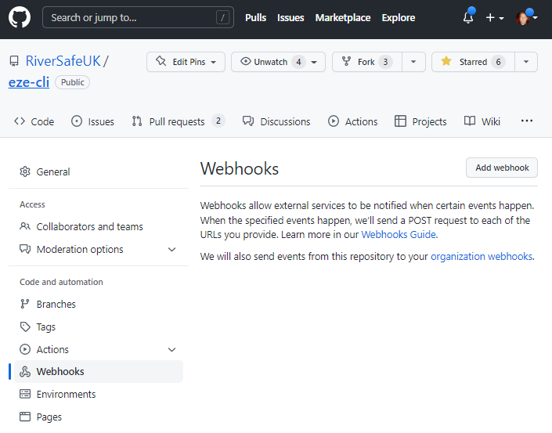
GIT: Remote GIT hooks
Git Server specific* configured endpoint hooks, that are called on events Commonly used by CI servers to start pipelines
https://docs.github.com/en/developers/webhooks-and-events/webhooks/about-webhooks

Slide 32
GIT: Pull Request
Git Serves provide UI for code reviewing

Slide 33
GIT BRANCH CONVENTIONS

Slide 34
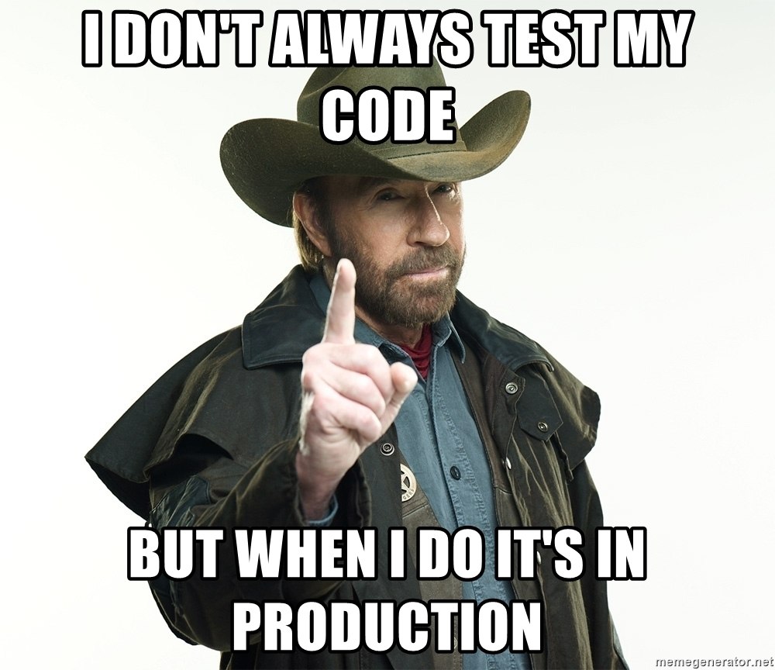
Branch Conventions: HERO

Slide 35
GIT: Usage: Branch Conventions
Three competing strategies For naming / maintaining Branches
Feature branching
Git Flow
Github Flow

Slide 36
GIT: Usage: Feature Branch
Separating development and production code
- Current release work is stored in main
- Next-release work is stored in develop
- work in progress in feature branches
(normally named feature/<TICKET>_<NAME>)

Slide 37
GIT: Usage: Feature Branch
Separating work in progress from finished code: Feature Branches
main is primary codebase branch
feature branches are forked from main*, for safely reasons
Development is done on feature branch
When safe and ready, branch merged back into main*
* develop or main depending on git-flow used by team (will be discussed later)

Slide 38
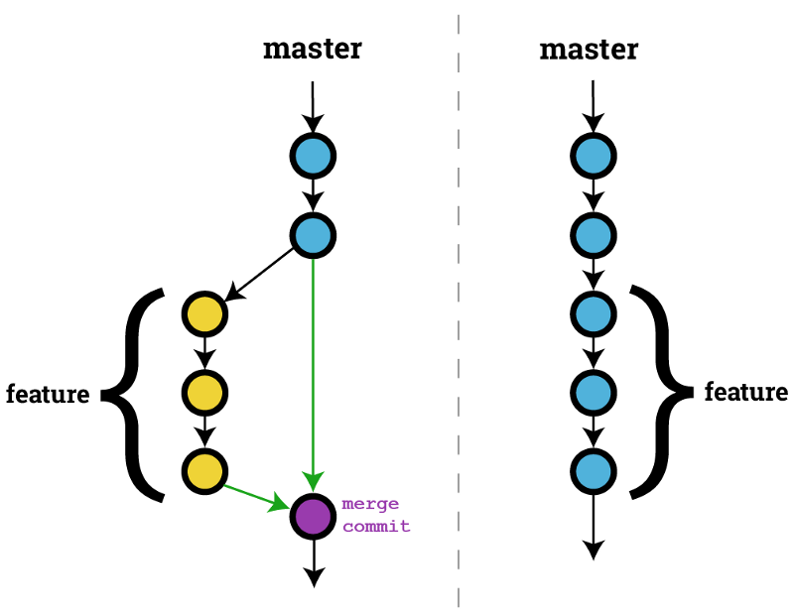
GIT: Usage: Feature Branch
Example of a feature branch:
being created from main
work committed
merged back into main
https://haydar-ai.medium.com/learning-how-to-git-merging-branches-and-resolving-conflict-61652834d4b0

Slide 39
GIT: Git Flow
Old grand daddy convention
Git Flow is a process of committing work to repos Git Flow keeps the repos tidy Git Flow stops branch soup
(it might be getting old…)
https://www.atlassian.com/git/tutorials/comparing-workflows/gitflow-workflow

Slide 40
GIT: Git Flow
Old grand daddy convention
5 types of branch
- main – released code
- develop – next release code
- feature branches – work in progress (merged into develop)
- Release tags – tags of main + version number
- hotfixes - emergency hotfixes to release branches

Slide 41
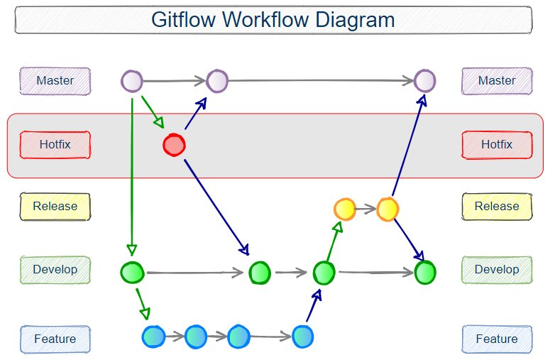
GIT: Usage: Git Flow
https://www.theserverside.com/blog/Coffee-Talk-Java-News-Stories-and-Opinions/Gitflow-release-branch-process-start-finish

Slide 42
GIT: Github Flow
new upstart convention
Github Flow is a process of committing work to repos Github Flow keeps the repos tidy Github Flow stops branch soup
Github Flow likes bleeding edge commits with no safeties or “releases”, aka continuous release

Slide 43
GIT: Github Flow
new upstart convention
2 types of branch
- main – released code
- feature branches – work in progress (merged into develop)
Bugs are fixed forward in feature branches

Slide 44
GIT: Github Flow
https://www.atlassian.com/continuous-delivery/continuous-integration/trunk-based-development

Slide 45
GIT: Git vs Github Flow
Opinions differ as to which is best
Typically:
Git Flow used for Versioned Software which are periodically released
Github Flow used for Services which are continuously developed
Feature branches for teams getting started with GIT

Slide 46
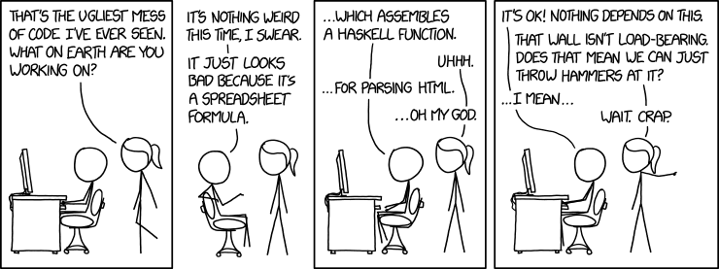
GIT Tooling HERO
https://www.explainxkcd.com/wiki/index.php/1926:_Bad_Code

Slide 47
GIT: Tooling
Are you a hero or a villain

Slide 48
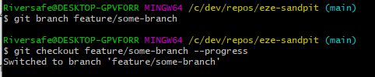
GIT: Tooling
Hero use raw git cli commands

Slide 49
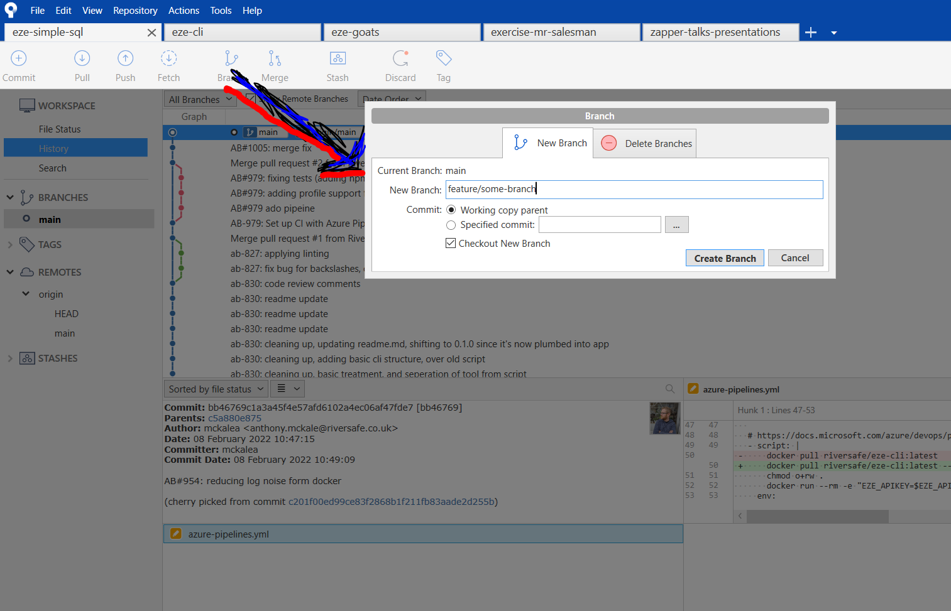
GIT: Tooling
Villian’s use git tooling aka SourceTree
or vscode

Slide 50
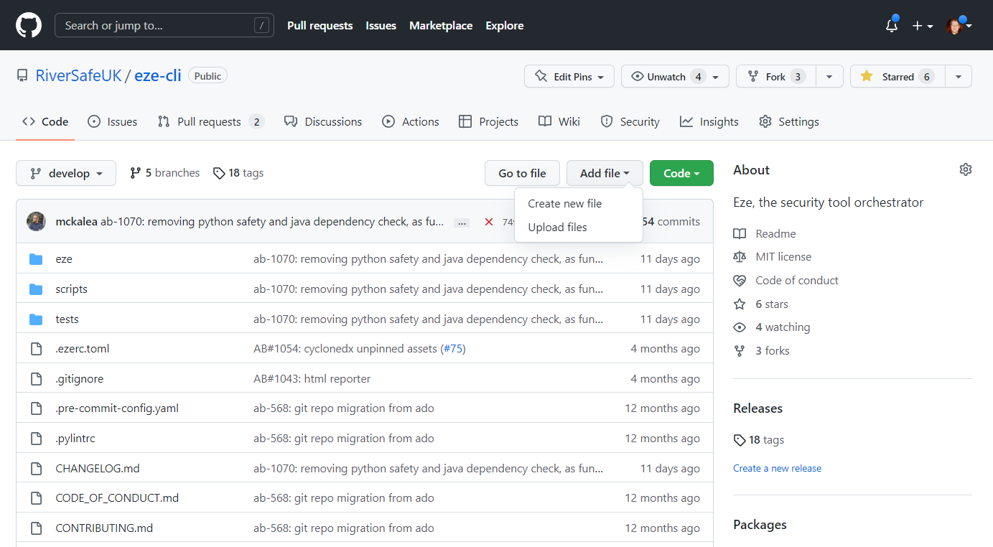
GIT: Tooling
DO NOT USE GITHUB UI THOUGH !!! Except for really simple stuff !

Slide 51
GIT: Tooling
The devil has the best tools
Your choice, but I use
SourceTree for branch Management
VSCode for committing / pull / push
Git CLI for debugging / disaster recovery
Github UI never ! ☺
Don’t be a Hero

Slide 52
GIT Best Practice

Slide 53
GIT: Best Practice
Use Git Flow / Github Flow
Never commit to main directly always merge via PR
Use PR / Peer review functionality in UI
https://vizer.sharepoint.com/:w:/r/sites/RiverSafe/_layouts/15/Doc.aspx?sourcedoc=%7B572D13FB-2157-47F7-B5CA-A75575FB66D6%7D&file=Git%20Best%20Practice.docx&action=default&mobileredirect=true

Slide 54
GIT: Best Practice
Never commit broken/incomplete work in main
Run tests before committing
never commit with broken tests
Always have a commit message
Follow commit message format TICKET: DESCRIPTION
https://vizer.sharepoint.com/:w:/r/sites/RiverSafe/_layouts/15/Doc.aspx?sourcedoc=%7B572D13FB-2157-47F7-B5CA-A75575FB66D6%7D&file=Git%20Best%20Practice.docx&action=default&mobileredirect=true

Slide 55
GIT: Best Practice
Use .gitignore
Never commit secrets/passwords into GIT
Never commit large files (over 1-2mb)
Use git hooks to run auto tests on commit
https://vizer.sharepoint.com/:w:/r/sites/RiverSafe/_layouts/15/Doc.aspx?sourcedoc=%7B572D13FB-2157-47F7-B5CA-A75575FB66D6%7D&file=Git%20Best%20Practice.docx&action=default&mobileredirect=true

Slide 56
Questions
I’ve been Anthony “Zapper” M^{c}Kale
Hopefully I’ve Educated, Informed, and even Entertained Good Testing is Good Security is Good software

Slide 57
Thank you

